Slide 1
JOHRTS Regional Freight Mobility Plan 2045
JOHRTS Transportation Planning Committee
May 27, 2021

Slide 2
Agenda
Welcome
Freight Goals
Goods Movement and the Economy
Major Regional Industries
Petroleum Refining Supply Chain
Resiliency
Programmed and Recommended Freight Projects

Slide 3
Freight Goals

Slide 4
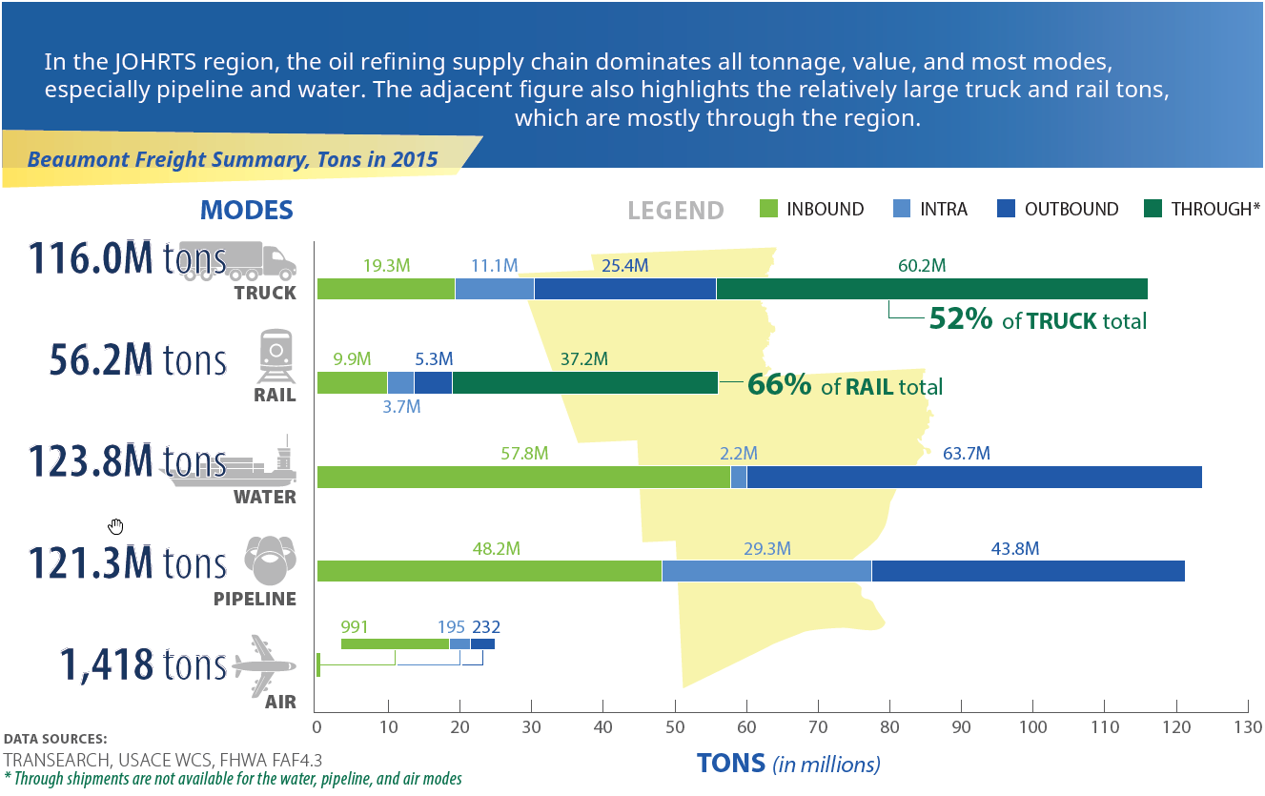
Goods Movement and the Economy
Notes:
Regional tonnage is dominated by the marine, pipeline, and truck modes and to a lesser extent rail.
Most freight is generated by the oil refining and chemical supply chains.

Slide 5
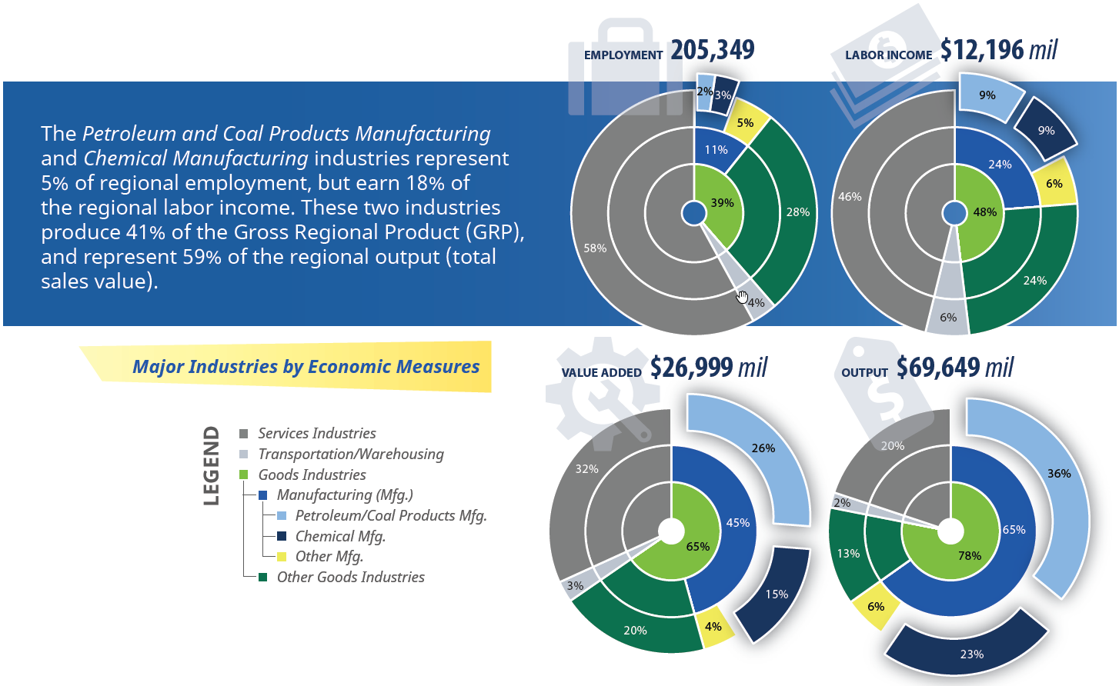
Major Regional Industries
Notes:
Petroleum and coal products manufacturing and chemical manufacturing represent just 5% of the region’s employment, but 59% of its economic output.

Slide 6
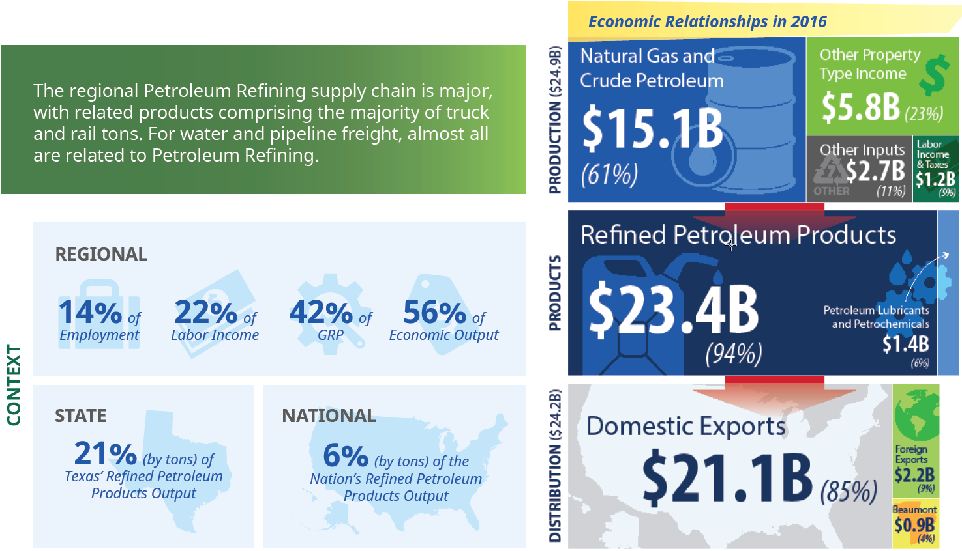
Petroleum Refining Supply Chain
Notes:
The region produces 6% of the nation’s refined petroleum products output.
Most of that product is distributed within the United States.

Slide 7
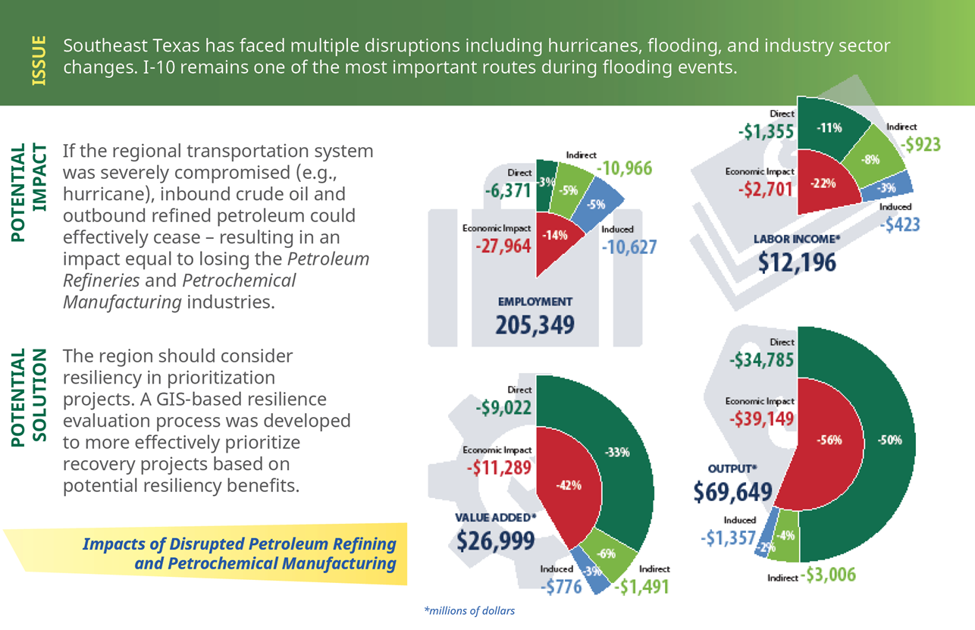
Resiliency

Slide 8
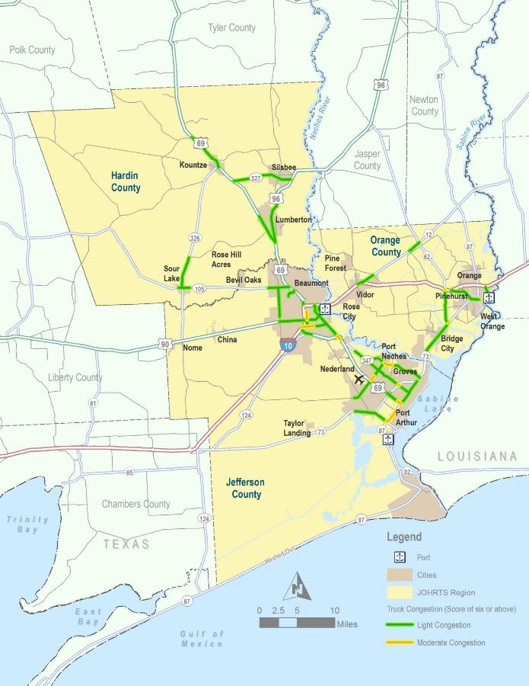
Future Freight Needs
Truck Bottlenecks
Ports – Port Capacity, Crane Upgrades, Rail Capacity.
Inland and Coastal Waterways – Deepen Sabine Neches Waterway to 48 feet.
Highways - I-10 Capacity, Truck Bottlenecks.
Railroads – Neches River Rail Crossing, Beaumont Rail Capacity.
Notes:
The region’s future freight needs are multimodal.
I-10 is the most critical freight route, so maintaining and improving capacity there is key.
First and last mile routes to the seaports are also important.
Deepening the Sabine-Neches Waterway and improving port operations are strategic regional projects.

Slide 9
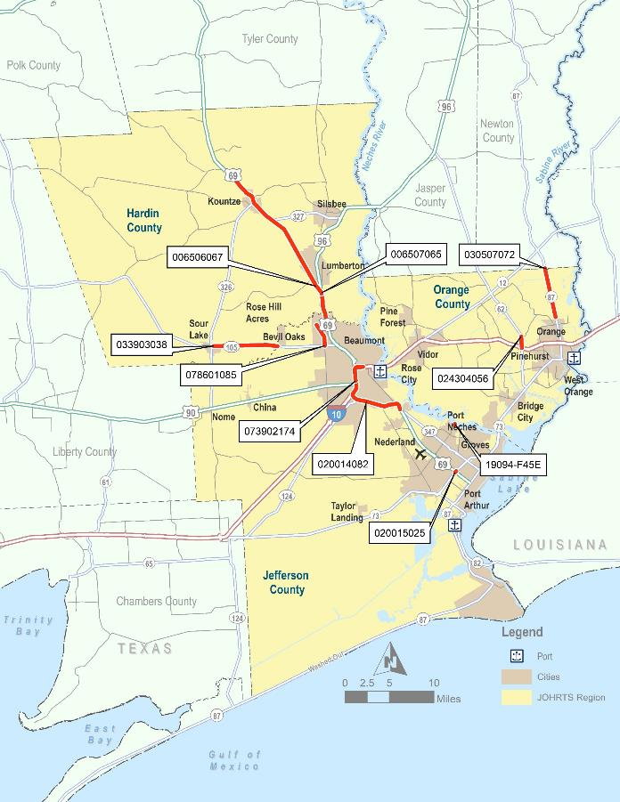
Programmed Projects Over the Next 25 Years
Key Projects 2020-2045
ID | NAME
02001408 | Widening of US 69/ Cardinal Dr
07390217 | IH-10 Widening and Interchange Reconstruction
02001502 | US 69 - SH 73 Interchange Improvements
03390303 | Widening of SH-105
00650706 | Widening of US 69
03050707 | Widening of SH 87
02430405 | Widening of SH 62
00650606 | Lumberton Bypass
07860108 | Widening of FM 364
19094-F4 | Port Neches Sidewalks
$1.9 Billion in Multimodal Transportation Investments Planned from 2020-2045

Slide 10
Recommended Freight Projects
Notes:
The current JOHRTS Metropolitan Transportation Plan (MTP) includes several projects addressing freight, but system needs and gaps remain.
The JOHRTS RFMP prioritized unmet freight mobility, safety, pavement, and bridge conditions. Resulting high-priority and adjacent projects were combined into 20 project packages to address these gaps.
Improvements on these routes will benefit regional freight movement and should be developed with freight in mind.

Slide 11
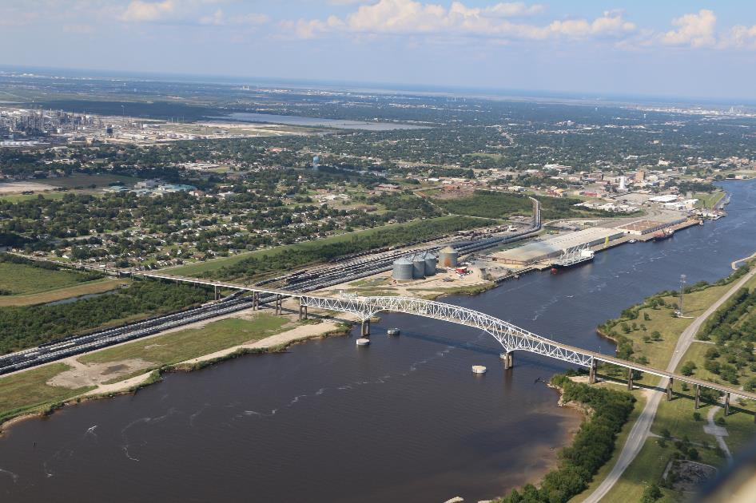
Questions
Bob Dickinson
Director, Transportation & Environmental Resources Division
South East Texas Regional Planning Commission
2210 Eastex Freeway, Beaumont, TX 77703
409-899-8444 ext. 7520
bdickinson@setrpc.org

